Slide 1

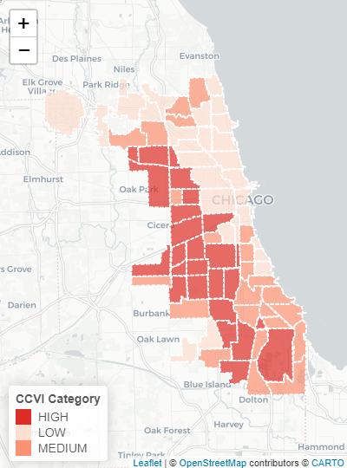
In the space below to copy/paste/insert a custom version (new color palette) of Figure 1 (map of CCVI Scores by Community Area) from the exercise.
GEO 3330 Sustainable Urban Transportation
Exercise #2: L Station Ridership Trends
Describe here any patterns you see in the map. Use data from the map to describe characteristics of at least one community located within each of the three CCVI categories.
Looking at the map, it seems like communities on the North side and center of the city have lower CCVI scores, while communities in the South and West sides have higher CCVI scores. An example of a community with a low CCVI score is Lincoln Park, which is ranked #3 in socioeconomic status, #2 in essential workers, and #1 in mobility. An example of a community with a medium CCVI score is Douglas, which is ranked #38 in socioeconomic status, #11 in essential workers, and #31 in mobility. An example of a community with a low CCVI score is West Englewood, which is ranked #72 in socioeconomic status, #11 in essential workers, and #74 in mobility.

Slide 2
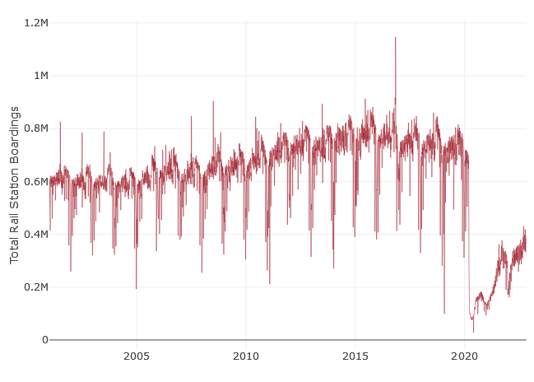
In the space below to copy/paste/insert Figure 2 or 3 from the exercise.
GEO 3330 Sustainable Urban Transportation
Exercise #2: L Station Ridership Trends
Describe patterns in rail boardings between 1999 and 2022. What do you think explains some of the cyclical variations in the data? What other factors may explain ridership over this period? Draw from the daily ridership plot to characterize ridership trends during the pandemic.
To me, it seems like ridership has been increasing from 199 to about 2015, and has been decreasing gradually until 2020, where the COVID pandemic caused a huge drop in ridership. Since then, ridership has been slowly increasing, but has yet to reach pre-pandemic levels. Furthermore, I believe that the cyclical variations can be explained by the fact that people may take the train more during the summer and warmer months than colder months. This trend was also evident during the pandemic as well.

Slide 3
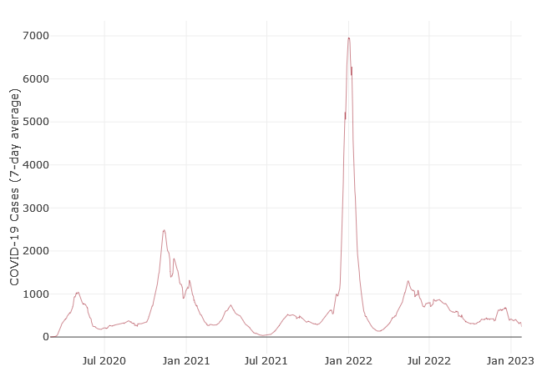
In the space below to copy/paste/insert Figure 4 from the exercise.
GEO 3330 Sustainable Urban Transportation
Exercise #2: L Station Ridership Trends
Are the waves and phases of the pandemic evident? Compare these pandemic phases to ridership trends over the same period. Do they appear to be related?
Looking at the chart, it seems that there are clear waves and phases of the pandemic. Looking at both charts, it seems like there appears to be a correlation between COVID cases and ridership, with months with higher COVID cases also seeing a decrease in ridership.

Slide 4
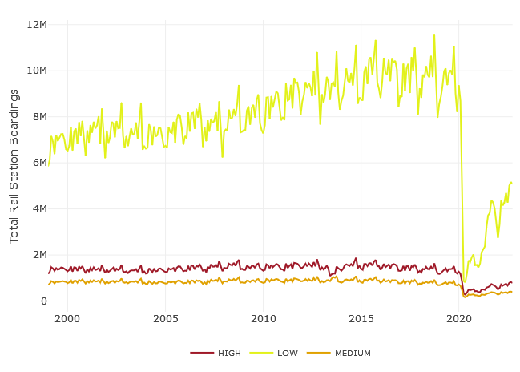
In the space below to copy/paste/insert Figure 5 or 6 from the exercise.
GEO 3330 Sustainable Urban Transportation
Exercise #2: L Station Ridership Trends
How does ridership vary with respect to station CCVI and line?
To me, it seems that stations with a high CCVI tend to have much lower ridership than stations with a lower CCVI. It is also interesting to note that stations with a higher CCVI recovered their ridership much quicker duringg the pandemic than stations with a lower CCVI. Furthermore, certain lines recovered much quicker as well, in particular the Red and Blue lines.

Slide 5
Summarize some potential short- and longer-term implications the pandemic has had on sustainable transportation and public transit ridership?
Some potential short-term implications that the pandemic may have is decreased ridership, as well as lower frequency of service due to transit operators getting sick. Some longer-term implications could be more people working from home, which can also lead to decreased ridership due to many not needing to commute to work. Another longer-term implication could be higher pay for transit workers due to transit agencies understanding their importance in regard to operations.
GEO 3330 Sustainable Urban Transportation
Exercise #2: L Station Ridership Trends
What strategies do you propose to help return transit to pre-pandemic levels?
Increase pay of transit operators in order to hire more so frequency can be increased
For Metra in particular, switch away from commuter rail model toward regional rail model, so trains come at more consistent times throughout the day
Attempt to increase ridership by ensuring stations and trains are clean, pleasant, and safe places to be in

